Slide 1






View Project on GitHub (Scan QR Code)

Slide 2
01
Feature Engineering

Slide 3

Data Leakage Prevention
To prevent data leakage, I removed extra training columns, ensuring the training and test datasets had identical features(after combining building details with the train and test sets).

Slide 4







Missing Value Handling
Dropped Features
Removed sparse columns like mobile_home_area, deck_area
Reason: Over 90% values missing → low informational value
Forwardfilling by Year (2019 → 2015)
Imputed historical trends across years for key features
↳ e.g., building_area_2019 → 2018 → ... → 2015

Slide 5





Three-Level Median Imputation
Applied to continuous features like assessed_value
Neighborhood median Region median (if missing) Global median (final fallback)
Captures locality-specific distribution without overfitting
Mode Imputation (Categorical)
Used for grade, foundation_type, etc.
Preserves most frequent category → stable and
interpretable

Slide 6



Encoding Strategies
Encoding Type | When Used | Example Features
Frequency Encoding | High-cardinality features to reduce dimensionality | neighborhood, region
Ordinal Encoding | Features with an inherent rank/order | grade, quality
Target Encoding | Selected features where relationship with target is strong | subneighborhood, zone

Slide 7
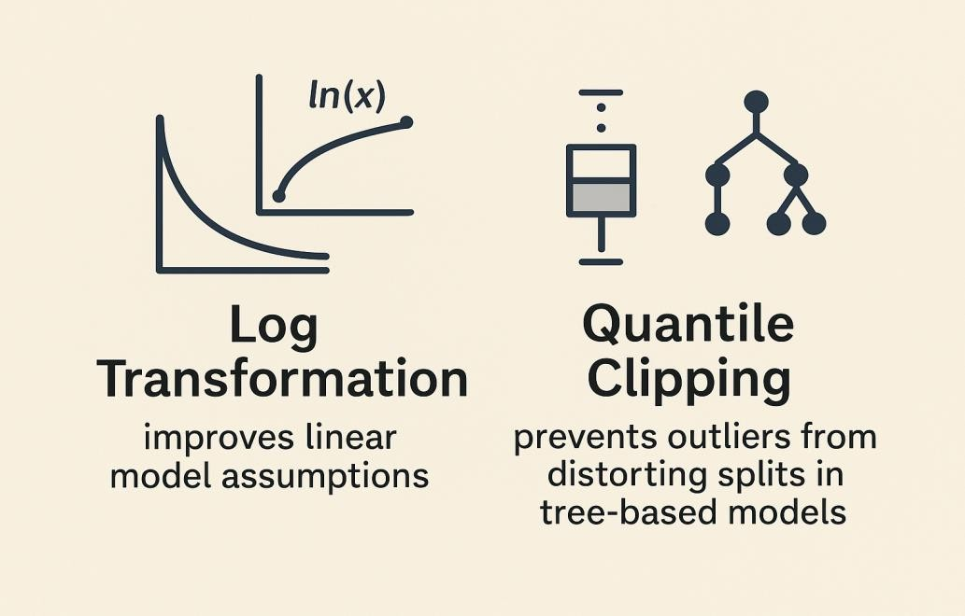
SKEWNESS

Slide 8
02
Modeling Strategy

Slide 9
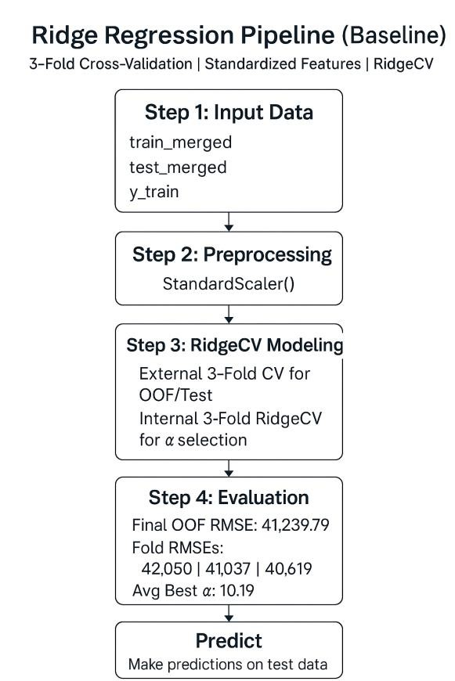
Ridge Regression

Slide 10
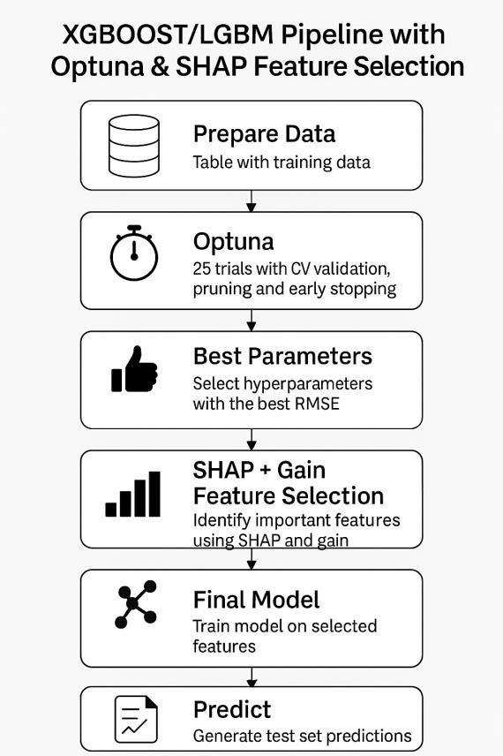
Tree-Based Models

Slide 11
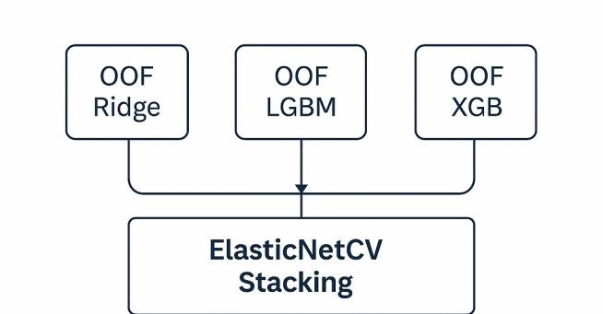
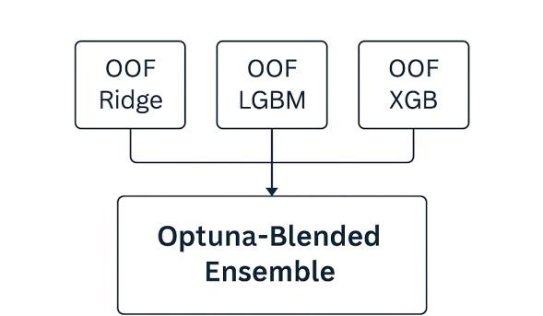
Ensemble Models

Slide 12


Final Takeaways
What worked well:
SHAP-driven feature selection (fold-safe)
Ridge + Tree model diversity in stacking
Smart tuning with Optuna’s Bayesian optimization
Next time:
Explore more advanced meta-learners or residual- based stacking and compare across different validation strategies.

